Slide 1

System Models
-Goutham

Slide 2
Table of contents
01
02
03
04
05
06
Introduction
Context
Model
Behavioral
Model
Data
Model
Object
Model
Structured
Methods

Slide 3

Gist of the story
A young boy, while wandering through the forest, discovered a fragile little bird lying helplessly on the ground. With tender care, he carried it back home, ensuring its safety. He placed the bird gently inside a cage, nourishing it until it regained strength. As days passed, the boy often gazed thoughtfully at his feathered companion, yearning to see it free again. Finally, with a joyful heart, he opened the window and released the bird, watching it soar gracefully into the boundless sky.

Slide 4
Perspective of Model
External
Behavioural
Structure
How the system interacts with its environment (users, other systems).
Context Diagram, Use case, DFD-Level 0
How the system behaves in response to inputs or events over time.
State Machine, Sequence, Activity, Event Driven Model
The static organization of the system architecture and data.
Class, ER, Component, Deployment Diagrams

Slide 5

02
Context Model

Slide 6
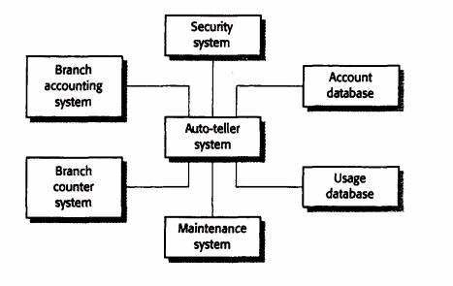
Context model of ATM
Show the boundary between the system being developed and its environment.
Help decide what is inside the system and what is outside the system.
If you define too wide a boundary, the system becomes expensive and complex.
If you define too narrow a boundary, the system may become inconvenient for users.
Boundaries are influenced not just by technical needs, but also by organizational or social factors.

Slide 7
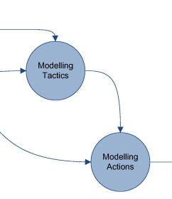
03
Behavioral Model

Slide 8
Behavioral models are used to describe the overall behavior of the system.
Types:
Data-flow models, which model the data processing in the system
State machine models, which model how the system reacts to events.
These models may be used separately or together, depending on the type of system that is being developed.

Slide 9
Data Flow Diagram
They are an intuitive way of showing how data is processed by a system.
At the analysis level, they should be used to model the way in which data is processed in the existing system.
They are used to show how data flows through a sequence of processing steps. The data is transformed at each step before moving on to the next stage.
They are valuable because tracking and documenting how the data associated with a particular process moves through the system helps analysts understand what is going on.
It shows a functional perspective where each transformation represents a single function or process. They are particularly useful during the analysis of requirements as they can be used to show end-to-end processing in a system.
Functional processing
Data stores
Data movements

Slide 10
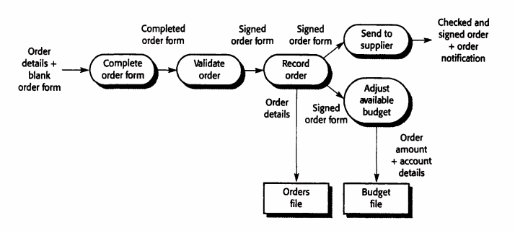
Data Flow Diagram of order processing.

Slide 11
State-Machine Diagram
Finite state machine or FSM) describes how a system behaves in terms of:
States : the different situations the system can be in.
Transitions : rules that define how the system moves from one state to another when an event occurs.
Events/Inputs : triggers that cause transitions.
Actions/Outputs : what the system does during or after a transition.
It describes how a system responds to internal or external events. It shows system states and events that cause transitions from one state to another. It does not show the flow of data within the system.
This type of model is often used for modelling real-time systems because these systems are often driven by stimuli from the system's environment.
A state machine model of a system assumes that, at any time, the system is in one of a number of possible states. When a stimulus is received, this may trigger a transition to a different state.

Slide 12
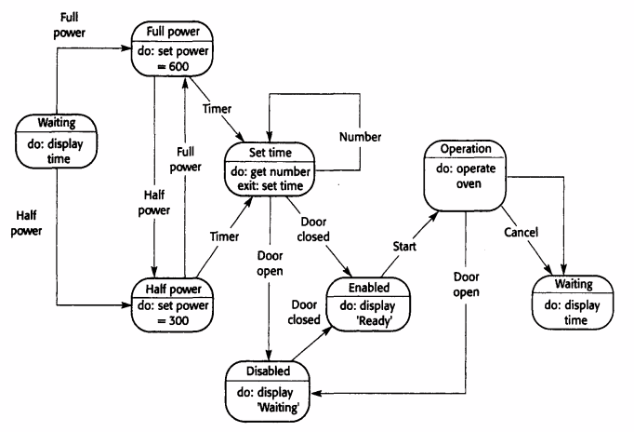
State-Machine Diagram for Simple Oven
Stimuli
System
State

Slide 13
Problem with State-Machine Approach
State machines model how a system changes from one state to another based on events.
But in large systems, the number of possible states and transitions grows very quickly called state explosion.
This makes diagrams complex, hard to read, and difficult to manage.
Solution
A superstate is a higher-level state that groups multiple related states together.
On the main diagram, the superstate looks like a single state (keeping the model simple).
Inside the superstate, engineers can expand it in a separate diagram to show the detailed states and transitions.

Slide 14
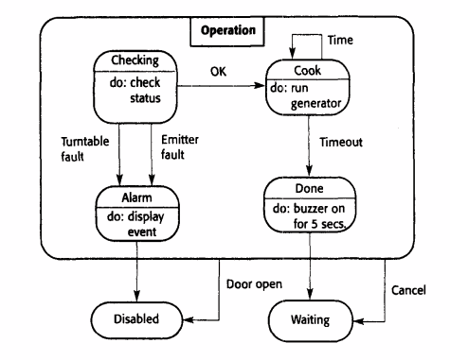
Operation State
The Operation state includes a number of sub-states. It shows that operation starts with a status check, and that if any problems are discovered, an alarm is indicated, and operation is disabled. Cooking involves running the microwave generator for the specified time; on completion, a buzzer is sounded. If the door is opened during operation, the system moves to the disabled state,

Slide 15
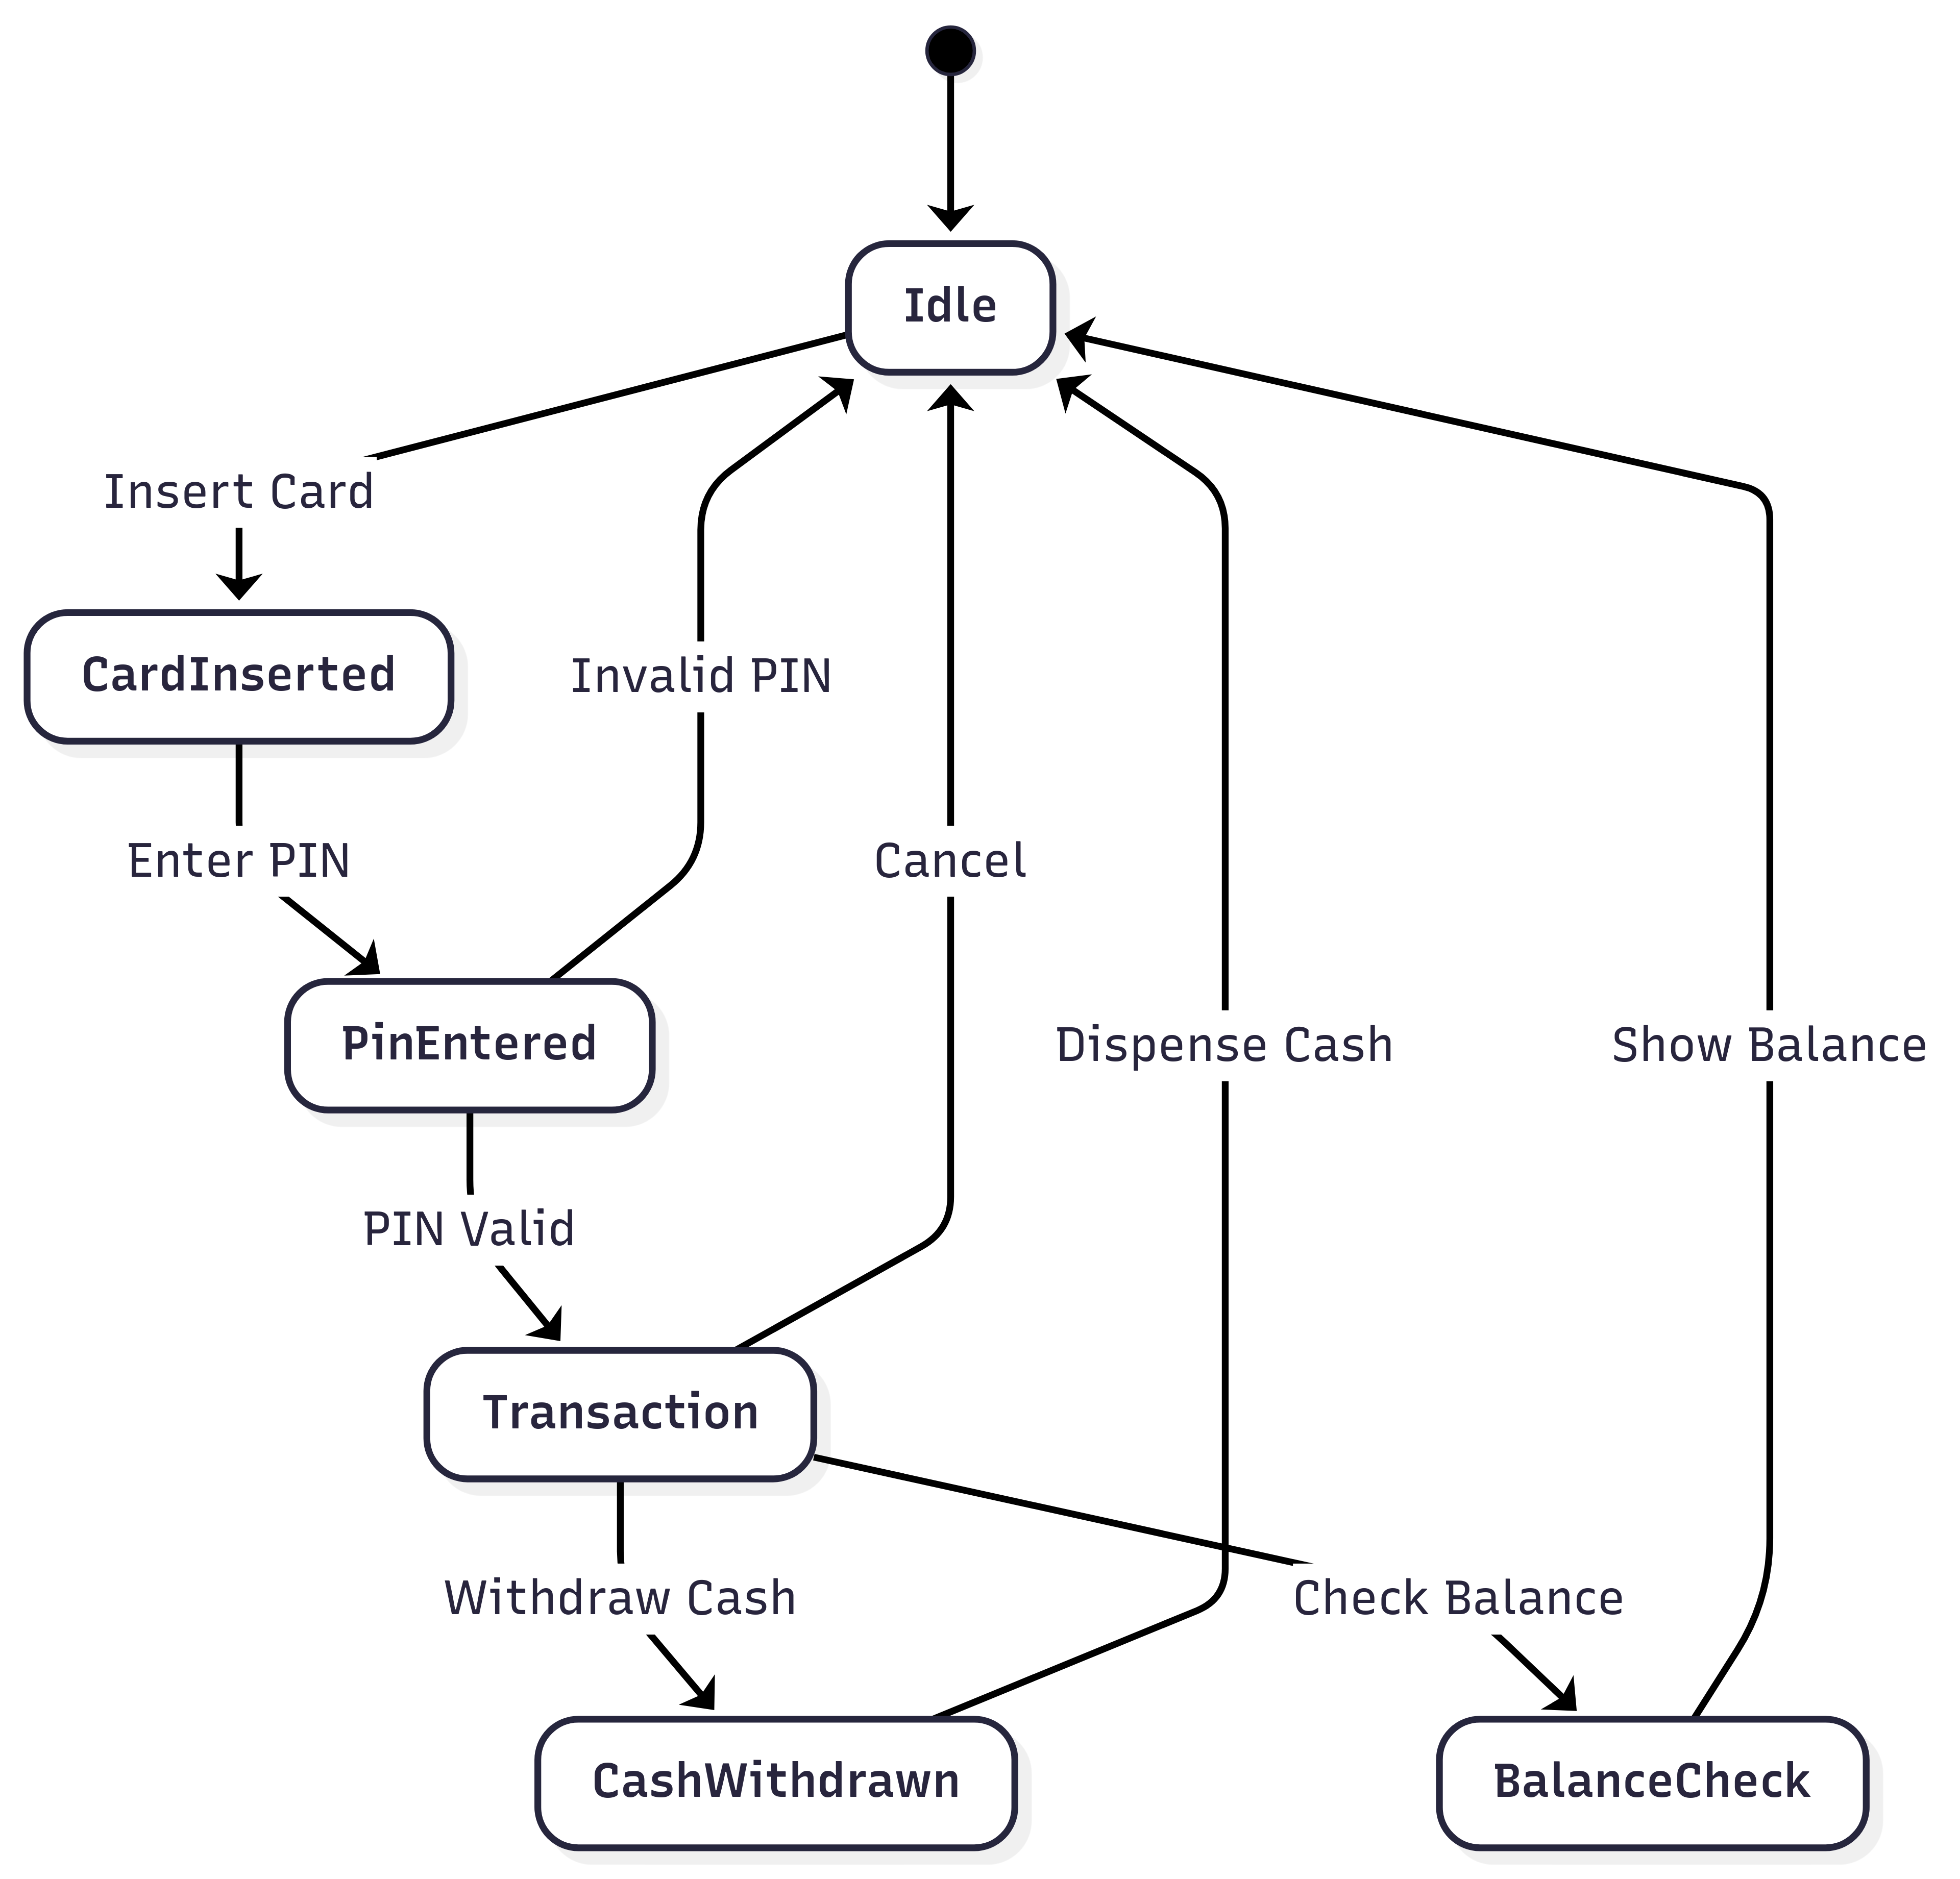
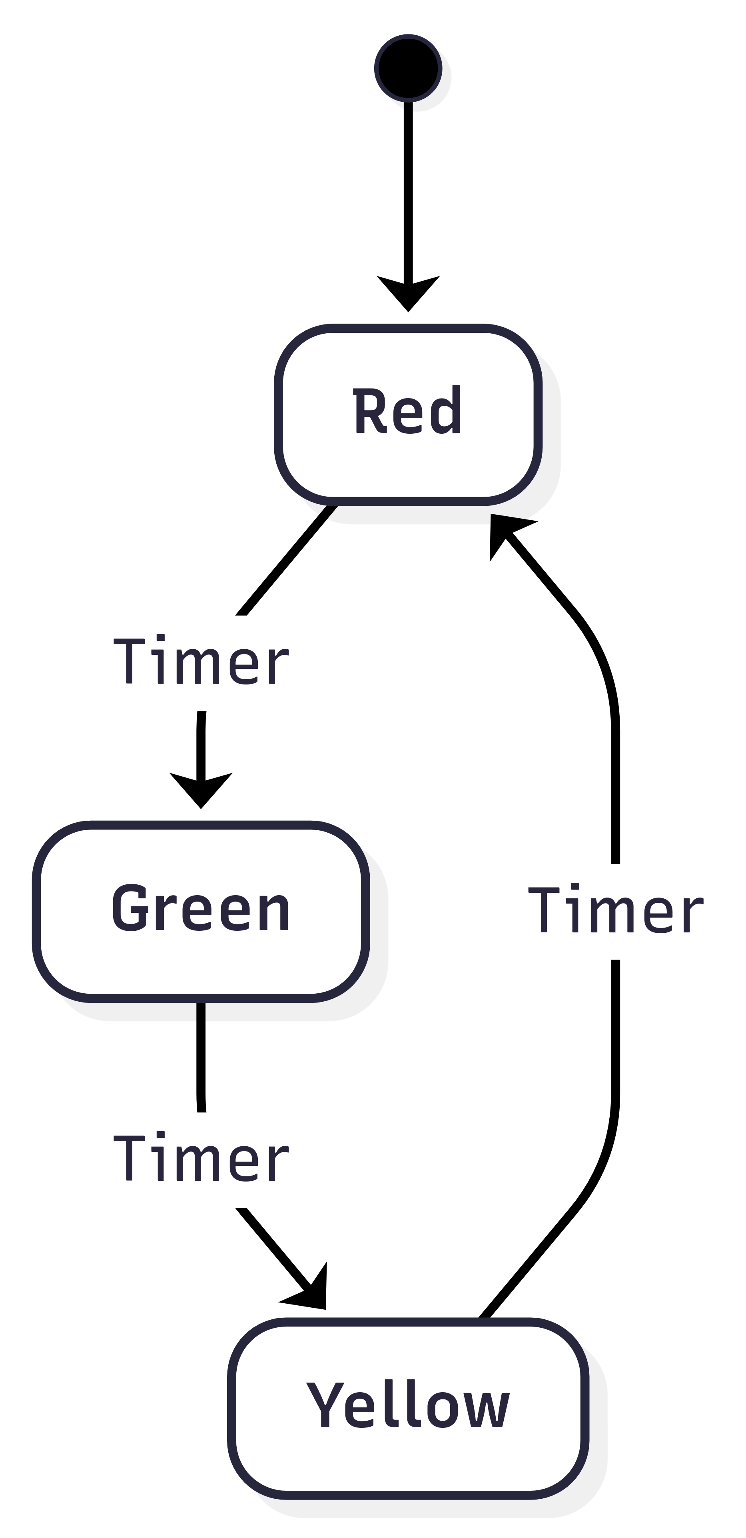
State-Machine Diagram for Traffic and ATM

Slide 16
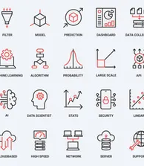
03
Data Model

Slide 17
Data models provide a conceptual picture of how data is stored, connected, and accessed.
Easier for both technical (developers) and non-technical (business users) people to understand.
A data model tells us what kind of data we can store (entities, attributes, relationships).
Requirements written in plain language can be interpreted differently.
Like all graphical models, data models lack detail, and you should maintain more detailed descriptions of the entities, relationships and attributes that are included in the model. You may collect these more detailed descriptions in a repository or data dictionary.

Slide 18
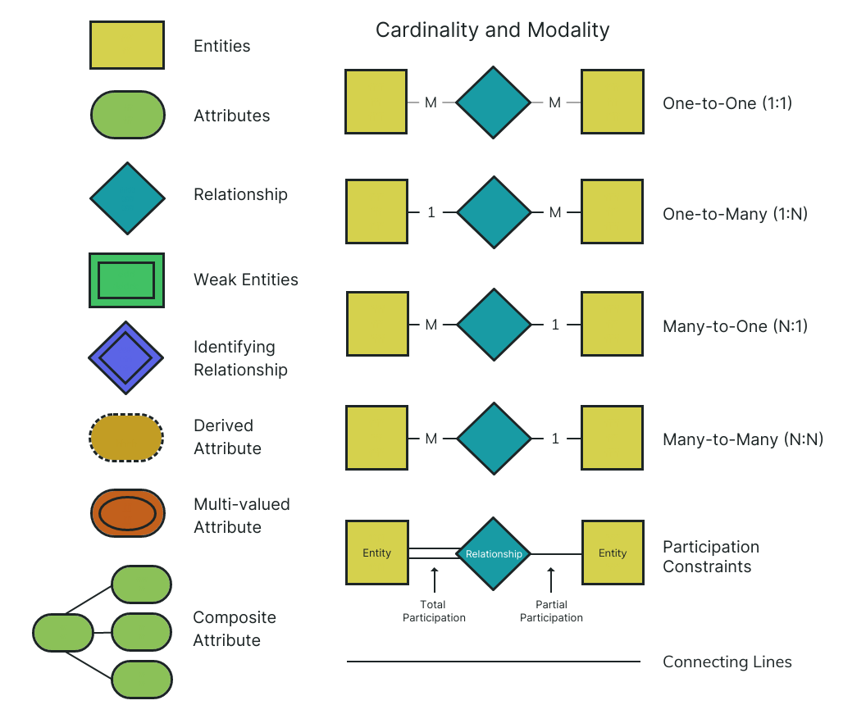

Slide 19
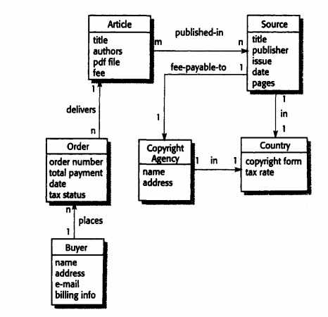

Slide 20
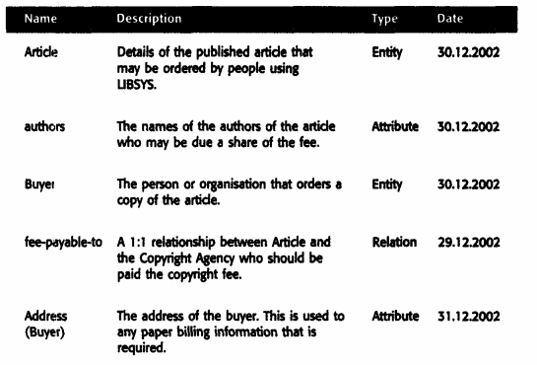
Data Dictionary
They are generally useful when developing system models and may be used to manage all information from all types of system models.
It is an alphabetic list of the names included in the system models. As well as the name, the dictionary should include an associated description of the named entity and, if the name represents a composite object, a description of the composition.
Other information such as the date of creation. the creator and the representation of the entity may also be included depending on the type of model being developed

Slide 21
Advantages of Data Dictionary
It is a mechanism for name management. Many people may have to invent names for entities and relationships when developing a large system model. These names should be used consistently and should not clash. The data dictionary software can check for name uniqueness where necessary and warn requirements analysts of name duplications.
It serves as a store of organizational information. As the system is developed, information that can link analysis, design, implementation and evolution is added to the data dictionary, so that all information about an entity is in one place.

Slide 22

04
Object Model

Slide 23
Modern software development often uses an object-oriented (OO) approach.
This means:
Requirements are described using object models.
Design is done in terms of objects and classes.
Implementation uses OO programming languages like Java, C++.
Object models represent both data and processing.
They combine the roles of data-flow diagrams (which show processing) and semantic data models (which show data structure).
They also show classification (how entities belong to groups) and composition (how entities are built from smaller ones).
Object Inheritance models that show how objects can be classified and can inherit attributes and operations from other objects
Aggregation models that show how objects are composed, and
Object behavioural models, which show object interactions.

Slide 24
Object Inheritance Model
Object-oriented modelling involves identifying the classes of object that are important in the domain being studied.
These are then organized into a taxonomy. A taxonomy is a classification scheme that shows how all object class is related to other classes through common attributes and services.
To display this taxonomy, the classes are organized into an inheritance hierarchy with the most general object classes at the top of the hierarchy.
More specialized objects inherit their attributes and services. These specialized objects may have their own attributes and services.

Slide 25
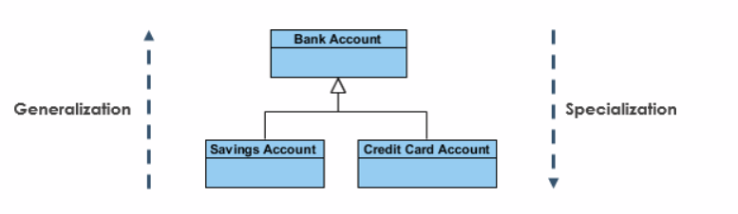

Slide 26
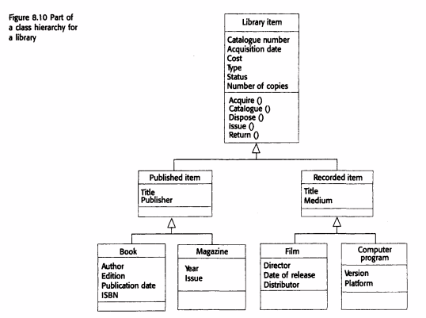
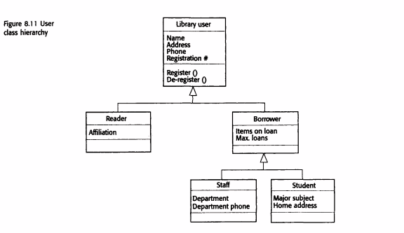

Slide 27
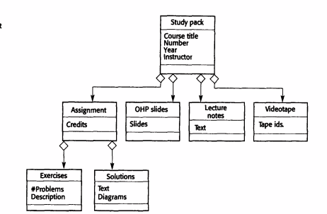
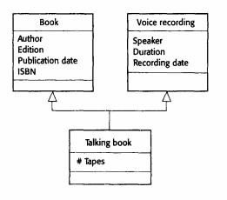
Object Aggregation Model

Slide 28
Coupling and Coehesion
Cohesion is how closely the attributes and methods of a class are related to each other (high cohesion is good).
High cohesion: Class does one thing well.
Low cohesion: Class does many unrelated things.
Coupling is the degree of interdependence between classes (low coupling is good).
Low Coupling : Classes only reference each other, not internals.
High Coupling : Classes reach inside each other, depending on exact implementation.

Slide 29
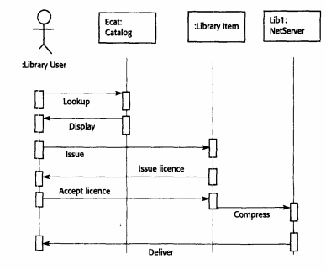
Object Behaviour Model

Slide 30
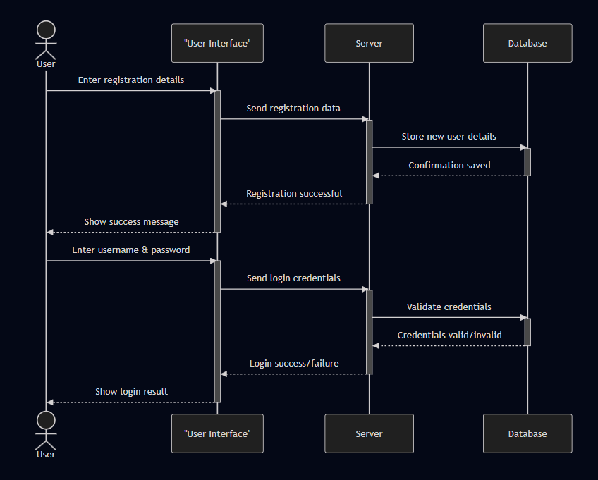

Slide 31
05
Structured Methods

Slide 32
A structured method is a systematic way of producing models of an existing system or of a system that is to be built.
Framework for Modeling: Structured methods provide a systematic approach to model systems in detail during requirements elicitation and analysis.
Standard Models and Processes: They define specific system models and a process to derive these models, following rules and guidelines.
Documentation and CASE Tools: Standardized documentation is produced, and CASE tools assist with model editing, code/report generation, and model checking.
Benefits: They are effective for large projects, reduce development costs, and ensure consistent, standardized design documentation.

Slide 33
Weakness of SM
Limited Nonfunctional Support: They do not effectively capture or model nonfunctional requirements (e.g., performance, security).
Lack of Guidance: They provide little help in choosing the right method for a problem or adapting it to a specific environment.
Excessive Documentation: They can generate too much detailed documentation, making it hard to see the core system requirements.
Complex Models: The models are often very detailed and hard to understand, making it difficult for users to validate their realism.

Slide 34
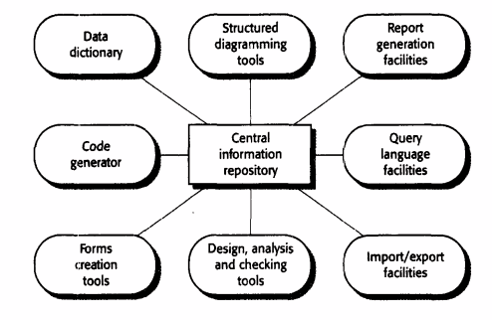
Components of CASE Tool

Slide 35
End of Chapter

